Slide 1
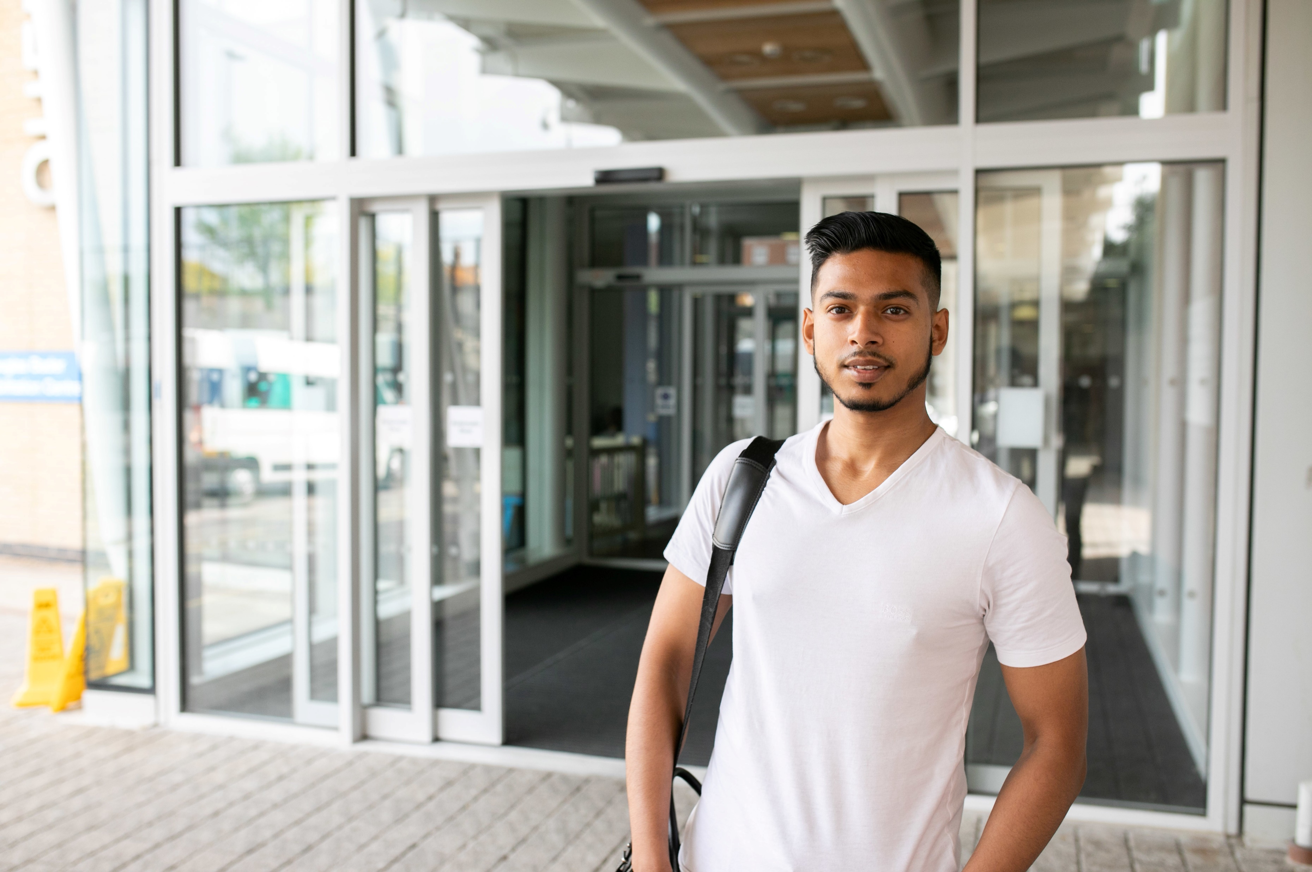
GP Access in Tower Hamlets – April to September 2022

Slide 2
Our data
Community Insights System (CIS) – used by all Healthwatch organisations in North East London
Gathers data online from social media, service provider websites, NHS Choices, Google Reviews etc., as well as from our outreach and engagement activities.
Issues relating to different service aspects are identified, and positive, neutral and negative sentiments are applied to each issue.
We analysed comments for 6 different service aspects that relate to access: Booking, Choice, Registration/Access, Telephone, Timing, and Waiting List.
Overall, there were 687 issues identified from 323 reviews. (Multiple issues and sentiments can be identified per review.)
GP Access in Tower Hamlets – April to September 2022

Slide 3
Key Findings
There has been a slight increase in positive feedback around GP Access in June and July due to an increase in positive comments relating to GP practices in PCN9.
The positive comments relate to quick response time to E-consult, short waiting times for appointments, and polite and helpful staff members.
However, it is evident that the residents in Tower Hamlets are having issues with accessing GP services for the following reasons:
Unable to get through on the phone
Long wait times over the phone
Lack of appointments / Only same day appointments available over the phone
Long wait times for non-urgent appointments (up to 4 weeks)
Being asked to fill in an e-consult (particularly difficult for elderly people, digitally excluded, and those who do not speak English)
E-consult not working or only working at specific times
GP Access in Tower Hamlets – April to September 2022

Slide 4
Sentiment around GP Access in Tower Hamlets
Out of all the issues identified from the feedback received between April and September 2022, majority of the feedback relating to the 6 service aspects (Booking, Choice, Registration/Access, Telephone, Timing, and Waiting List) were negative in sentiment.
Compared month on month, there was a steady decline in the proportion of negative feedback while the proportion of positive feedback increased from May to July and has remained at 26%.
GP Access in Tower Hamlets – April to September 2022

Slide 5
Breakdown of Key Themes
When comparing each service aspect, Booking (n.262), Telephone (n.111), and Waiting List (n.227) were the three most commented on.
Telephone had the highest proportion of negative sentiments.
GP Access in Tower Hamlets – April to September 2022

Slide 6
Sentiment by Primary Care Networks (PCNs)
When comparing feedback for each Primary Care Network in Tower Hamlets, PCN9 had the highest proportion of positive feedback (38%) and PCN6 had the lowest (9%).
GP Access in Tower Hamlets – April to September 2022

Slide 7
Sentiment by Primary Care Networks – Month by Month
When comparing the different PCNs in Tower Hamlets, we can see that PCN9 had a big increase in positive feedback in June (n.16) and July (n.19), and again in September (n.13) whereas PCN8 had a drop in negative feedback in May (from 37 to 13) but have seen an increase in September (n.24).
GP Access in Tower Hamlets – April to September 2022

Slide 8
Sentiment around GP Access in Tower Hamlets
When looking at the specific service aspects and the number of positive and negative sentiments month by month, the number of positive sentiments around Booking and Waiting List increased in July which would likely be due to an increase in positive feedback for PCN9. The number of negative sentiments around Booking and Telephone have slightly decreased in recent months.
GP Access in Tower Hamlets – April to September 2022

Slide 9
Positive Feedback
From the comments containing positive sentiments around the 6 service aspects, we identified the following themes that were mentioned most often:
Quick response time
“Over the last year I have needed to use the practice a few times. I have found their response to online consultations to be quick and thorough.”
“Easy online experience, Quick response. I always used the phone to contact the surgery, but first time I used the online contact, and found it easy to use.”
“When I ring for appointments I get through on the phone quickly and a doctor always rings me back that same day.”
Short waiting time for an appointment
“I rang the surgery on 8 June having had some worrying symptoms for over a week. I explained my concern and had a telephone consultation with a GP later that morning. The GP needed to physically examine me and arranged for me to go to the surgery the next morning.”
“I registered on Friday morning online and requested an appointment. I was called on Friday lunchtime and requested a doctor's appointment on Monday. By Monday afternoon I had an appointment with a doctor.”
Polite and helpful staff members
“The GP’s are knowledgeable and thorough and ensure they are monitoring treatment well. The receptionists are professional and helpful and the practice nurses and HCA are wonderful in their provision of care.”
“Staff was extremely friendly and helpful. Quick to assist me in making me an appointment last week. Explaining the GP booking system confidently and easily for me to understand.”
*E-consult is a form of digital triage. Patients go online and submit information about medical or administrative requests to their own doctors. This request is sent to the GP practice to decide on the right care. Source: https://econsult.net/econsult-faqs

Slide 10
Negative Feedback
From comments containing negative sentiments around the 6 service aspects, we identified the following key issues that were mentioned most often:
Unable to get through on the phone / Long wait time on the phone
“I have been trying to get an appointment and have been on hold for an hour. They say they open their phone lines at 8:30 however I am still waiting to get through an hour later. This is poor.”
“Waited for an hour and a half in the caller queue, only to be cut off when I was number 3. Urgently need medication.”
Long wait time for an appointment
People reported having to wait for a non-urgent appointment for up to 4 weeks.
“You will be lucky to get an appointment in 3 weeks and only on the telephone.”
“Staff is very helpful and kind, keen to listen to you and deliver answers for any of your concerns; only downside is that you usually have to wait for an appointment for at least 2 weeks.”
“Appointments take 3-4 weeks to be booked and you are asked to wait for a phone call which can occur any time of the day.”
GP Access in Tower Hamlets – April to September 2022

Slide 11
Lack of appointments / Only same day appointments available over the phone
People reported calling their GP practice to book an appointment only to be told there were no appointments left. Several people also mentioned that when calling their practice, they are only offered a same day appointment. For any other appointments, they were asked to fill in an e-consult.
“I've been trying to book a face-to-face appointment for my disabled and severely vulnerable father for over a week. Each time I call I'm told to call back another day.”
“They only make same day appointments- I called the moment they open, was in a virtual queue with 7 people ahead of me and by 8:10 am there were no more appointments - and this is not the first time it happens. I generally avoid even calling them unless I am in pain.”
“Getting an appointment is near enough impossible. I’m confused as to why they only do on the day appointments, and you can’t book in advance. I’ve waited nearly an hour on the phone to then be told no appointments are available and to do an online consultation which sometimes takes a week to get an appointment booked it.”
Request to fill in E-consult*
“This place never ever has any appointments, since Covid pandemic they have forced everyone to book appointments on the app, they do not take any by phone, they only release slots at certain time in the morning and they are always gone.”
“They advise you to fill eConsult form for anything urgent, for which you need to answer 30+ questions, then after 3-5 days wait you only get a response not helpful at all.”
“The health centres policy of e-consult first is absolute rubbish. You won’t hear from them sometimes not even after 3 weeks and still waiting.
What about people who struggle with online services and text messages they have to do the same and still at no avail.”
*E-consult is a form of digital triage. Patients go online and submit information about medical or administrative requests to their own doctors. This request is sent to the GP practice to decide on the right care. Source: https://econsult.net/econsult-faqs

Slide 12
No call back/reply
“Tried to book a GP appointment for a month now. Didn’t get an email reply when they said they would reply, didn’t get a text message after calling when they said they would text either.”
“Called up for a friend who I was interpreting for in regards to her son who was quite sick. I was told a GP will call the same day. No one called. So we called again the next day to be told a call will be made, again nothing. So my friend walked in crying with her child and she was told to leave the premises. No interpreter used no help offered at all.”
“Twice now over the last couple of years I’ve arranged an appointment by phone making time for it by taking a day off work and haven’t been called. This second time, after not being contacted I called them. They apologised and said the doctor would call back at the end of the day but he did not.”
Rude Staff
“I am pregnant and trying to get an appointment with doctor to discuss my thyroid issues. The receptionists are so rude, and treats patients really bad. They shouted on me because I asked for an appointment.”
“Like many others reviewing, the service from receptionists has made me come online to post my experiences. They are very rude for no reason whatsoever and will put people off from calling to book an appointment. The receptionist team should be tip top as they are the first port of contact for any brand and often represent the internal works.”
“That receptionist is extremely rude. My english is not so good, so I asked one or two times "sorry?" to which she responded very rudely almost shouting at me merely repeating the same question without explaining the question. One of the doctors that I spoke with, understood my ethnic background and spoke and explained in so many ways.”
GP Access in Tower Hamlets – April to September 2022

Slide 13
E-consult not working or only working at specific times
“Long line to even for them to receive the phone, can’t get any appointments at all and they say to do e-consults but they don’t even keep the consults open the whole day or anything.”
“Long wait times on the phone, only to be told to use econsult, and when you try to do that, website states unavailable!”
“Online consultations haven't worked. When there are no appointments and you are directed to an online consultation form and it tells you to visit the pharmacy when you already have and the Pharmacists says the only option is to see your GP. The online form isn't done well as you can be straight up denied depending on how you answer the questions.”
GP Access in Tower Hamlets – April to September 2022

Slide 14
Conclusion
Based on the feedback in this report, Healthwatch Tower Hamlets would recommend exploring some of the following suggestions in order to ease the pressure on staff members and to enable services to better meet patients’ needs.
Investigate what has increased the number of positive feedback for PCN9 and share learnings and good practice with other PCNs to replicate any processes that have been proven to work.
Prioritise phone lines for the elderly, digitally excluded, and those who do not speak English.
Offer non-urgent appointments over the phone as well as through E-consult.
Direct younger patients and those who work to use E-consult.
Increase the opening times for E-consult.
GP Access in Tower Hamlets – April to September 2022

